Slide 1
Lecture 04
Bill Perry

Slide 2
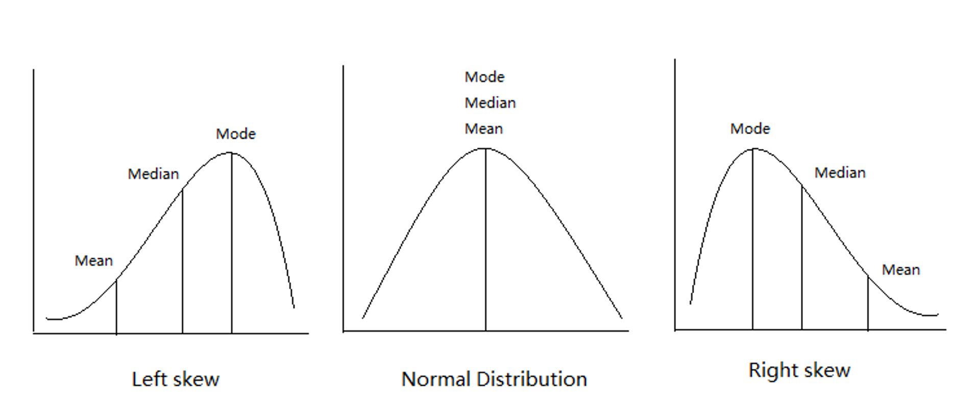
Lecture 3: Review
Introduction to histograms or frequency distributions
Probability Distribution Functions (PDF)
Descriptive Statistics
Center - mean, median, mode
Spread - range, variance, standard deviation
Our last graphs

Slide 3
Practice Exercise 1: Recreating Our Last Histograms
Let’s recreate the basic histogram of fish lengths from our last class. Use the sculpin_df data frame that’s already loaded.
# Write your code here to create a histogram of fish lengths from Toolik Lake # Remember to use the pipe operator %>% and ggplot with geom_histogram()

Slide 4
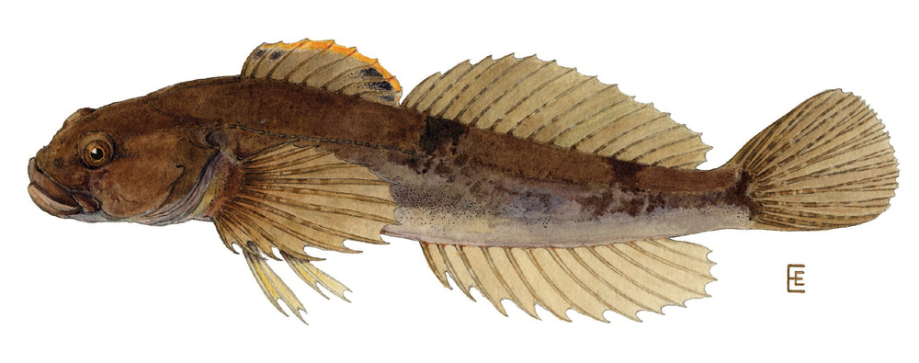
Lecture 4: Lecture Overview
The objectives:
Introduction to hypothesis testing
The standard normal distribution
Standard error
Confidence intervals
Student’s t-distribution
H testing sequence
p-values

Slide 5
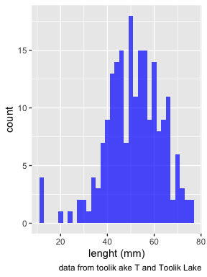
Lecture 4: Standard normal distribution
To understand hypothesis testing need to understand standard normal distribution
Recall - sculpin in Toolik Lake
n = 208
mean = 51.69 mm
std dev = s = 12.02 mm
Weight distribution ~normal

Slide 6
Practice Exercise 2: Compare Fish Distributions from Different Lakes
Let’s look at what lakes are in our dataset:
# View the unique lake names unique(sculpin_df$lake)
[1] "E 01" "E 05" "NE 12" "NE 14" "S 06" "S 07" "Toolik"
Now, select two lakes and create a comparison of their fish length distributions using facet_grid():
# Your code here to compare fish lengths between two lakes of your choice

Slide 7
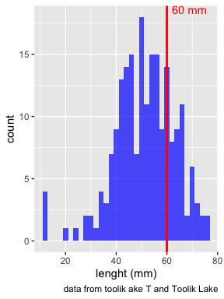
Lecture 4: Standard normal distribution
You want to know things about this population like
probability of a baby born at the hospital having a certain length (e.g., > 60 mm)
Can solve this by integrating under curve
But it is tedious to do every time
Instead
we can use the standard normal distribution (SND)

Slide 8
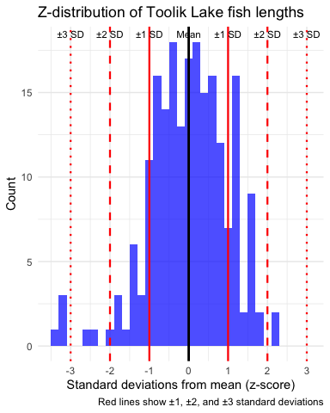
Lecture 4: Standard normal distribution
Standard Normal Distribution
“benchmark” normal distribution with µ = 0, σ = 1
The Standard Normal Distribution is defined so that:
~68% of the curve area within +/- 1 σ of the mean,
~95% within +/- 2 σ of the mean,
~99.7% within +/- 3 σ of the mean
*remember σ = standard deviation

Slide 9
Lecture 4: Standard normal distribution
Areas under curve of Standard Normal Distribution
Have been calculated for a range of sample sizes
Can be looked up in z-table
No need to integrate
Any normally distributed data can be standardized
transformed into the standard normal distribution
looked up ion a table

Slide 10
Lecture 4: Standard normal distribution
Done by converting original data points to z-scores
Z-scores calculated as:
$\text{Z = }\frac{X_{i}−μ}{σ}$
z = z-score for observation
xi = original observation
µ = mean of data distribution
σ = SD of data distribution

Slide 11
Practice Exercise 3: Calculate Z-Scores
Let’s practice calculating z-scores for fish lengths. Calculate the z-scores for:
A fish that is 25 mm long
A fish that is at the mean length (approximately 51.7 mm)
A fish that is 60 mm long
# Calculate z-scores for these three fish lengths # Remember the formula: Z = (value - mean) / standard deviation
Now use your calculated z-scores to determine roughly where these fish fall in the overall distribution: - What percentage of fish are smaller than the 25 mm fish? - What percentage of fish are larger than the 60 mm fish?
# Use the pnorm() function to calculate these percentages

Slide 12
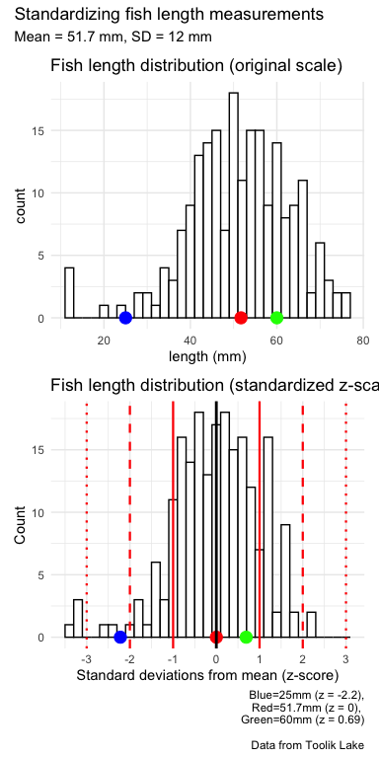
Lecture 4: Standard normal distribution
Thus:
z-score = value - mean/s
z-score of 25mm = (25 - 51.7) / 12 = -2.225
z-score of 51.7mm = (51.7 - 51.7) / 12 = 0
z-score of 60mm = (60 - 51.7) / 12 = 0.6916667

Slide 13
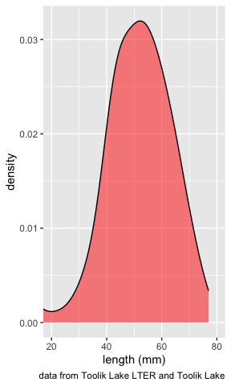
Lecture 4: Standard normal distribution
Area under curve (probability) of standard normal distribution is known relative to z-values
Knowing z-value, can figure out corresponding area under the curve
What is the area under curve < 0?

Slide 14
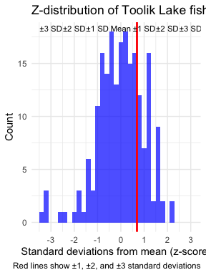
Lecture 4: Standard normal distribution
Here is z-score table for right side or positive values of the z distribution (z > 0)
Numbers give area under the curve to left of a particular z-score
say 60 mm as a z score of 0.6916667

Slide 15
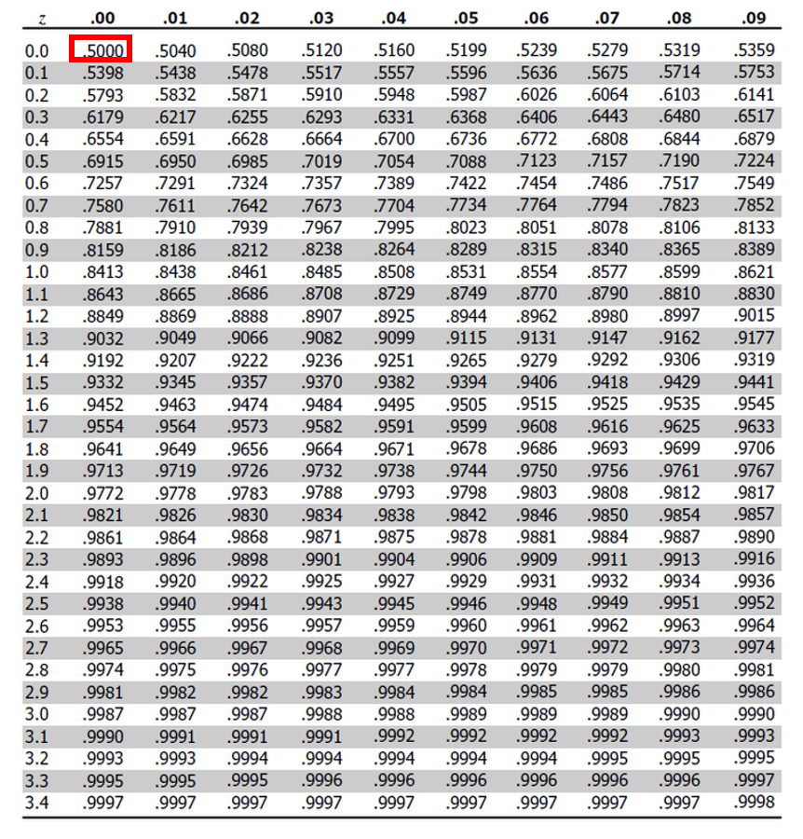
Lecture 4: Standard normal distribution
Area under curve (probability) of standard normal distribution is known relative to z-values
Knowing z-value, can figure out corresponding area under the curve
What is the area under curve < 0?
0.5 of the area of the curve is contained to the left of z = 0.00

Slide 16
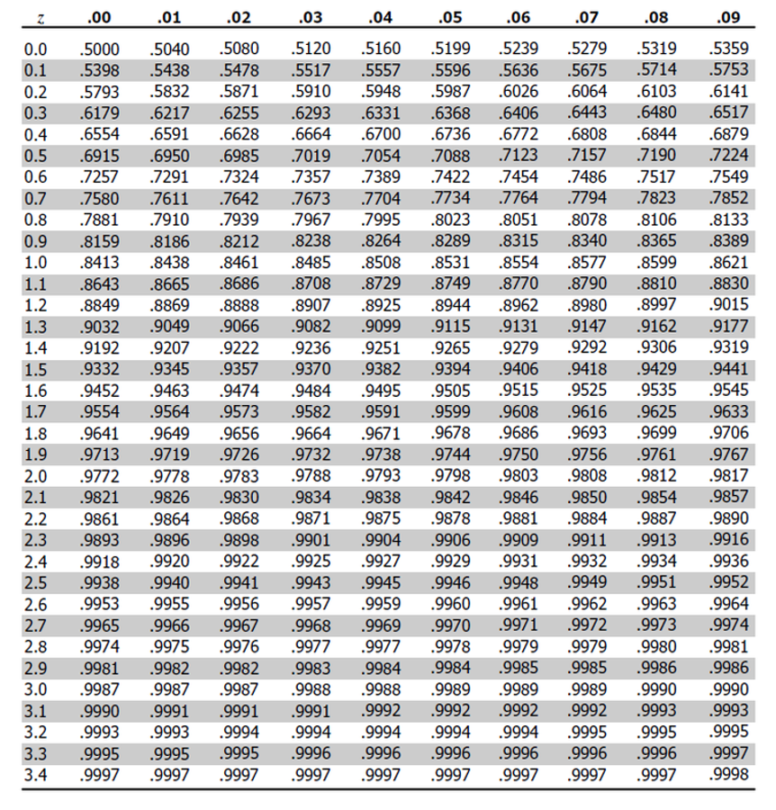
Lecture 4: Standard normal distribution
area of the curve is contained to the left of z = 1.22
0.8686 or 86.9%

Slide 17
Practice Exercise 4: Working with Probabilities
Using the z-table or the built-in R function pnorm(), answer these questions:
What percentage of fish in Toolik Lake are expected to be longer than 65 mm?
# Convert 65 mm to a z-score z_65mm <- (65 - toolik_result$mean) / toolik_result$sd # Find the probability of a fish being larger than 65 mm prob_larger_than_65mm <- 1 - pnorm(z_65mm) prob_larger_than_65mm * 100 # Convert to percentage
[1] 13.4254
Between what two lengths would you expect to find the middle 90% of fish in Toolik Lake?
# Find the z-scores for the 5th and 95th percentiles z_5 <- qnorm(0.05) z_95 <- qnorm(0.95) # Convert these z-scores back to fish lengths length_5 <- toolik_result$mean + z_5 * toolik_result$sd length_95 <- toolik_result$mean + z_95 * toolik_result$sd c(length_5, length_95) # The middle 90% of fish lengths
[1] 31.91600 71.47343

Slide 18
Lecture 4: Standard normal distribution
What is the area of the curve is contained between of z = 0 and z=1.5?

Slide 19
Lecture 4: Standard normal distribution
What is the area of the curve is contained between of z = 0 and z=1.5?
approximately 0.4332 (or 43.32%)
To calculate this from a standard normal table:
To find the area under the standard normal curve between 0 and 1.5 using this table:
Locate z = 1.5 in the table - 0.9332.
represents P(Z ≤ 1.5) - probability Z is less than or equal to 1.5
Since need area between 0 and 1.5 - need to subtract P(Z ≤ 0) from P(Z ≤ 1.5)
From table - P(Z ≤ 0) = 0.5000.
Therefore, the area between 0 and 1.5 is: 0.9332 - 0.5000 = 0.4332.

Slide 20
Lecture 4: Standard normal distribution
What is the area of the curve is contained to the left of z = -1?

Slide 21
Lecture 4: Standard normal distribution
What is the area of the curve is contained to the left of z = -1?
Locate row for 1.0 - (table shows absolute value of z) and the column for .00
value = 0.8413 - represents P(Z ≤ 1.0)
However want P(Z ≤ -1.0)
need to use the symmetry property of the standard normal distribution:
P(Z ≤ -1.0) = 1 - P(Z ≤ 1.0) = 1 - 0.8413 = 0.1587
Therefore, 15.87% of area falls to the left of z = -1.0

Slide 22
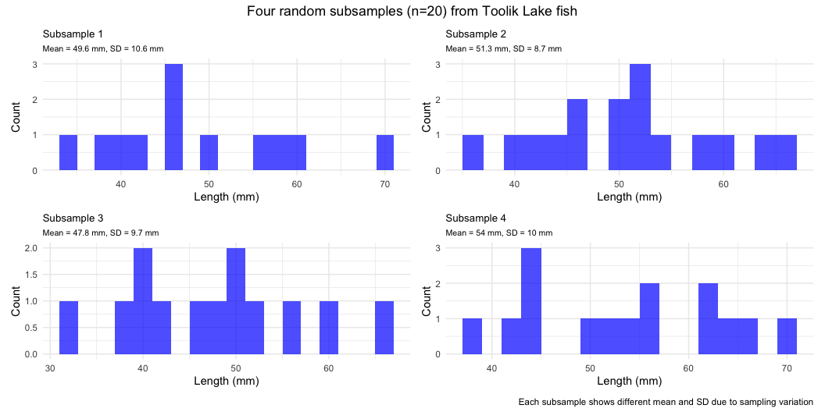
Lecture 4: Standard error
Take random samples from fish population:
3 random samples (each n=20) from population:
Notice the sample statistics and distributions

Slide 23
Practice Exercise 5: Sampling Distributions
Let’s explore how sample size affects our estimates by taking samples of different sizes:
# Set seed for reproducibility set.seed(456) # Create samples of different sizes small_sample <- toolik_df %>% sample_n(10) medium_sample <- toolik_df %>% sample_n(30) large_sample <- toolik_df %>% sample_n(100) # Calculate mean and standard error for each sample small_mean <- mean(small_sample$total_length_mm, na.rm = TRUE) small_se <- sd(small_sample$total_length_mm, na.rm = TRUE) / sqrt(10) medium_mean <- mean(medium_sample$total_length_mm, na.rm = TRUE) medium_se <- sd(medium_sample$total_length_mm, na.rm = TRUE) / sqrt(30) large_mean <- mean(large_sample$total_length_mm, na.rm = TRUE) large_se <- sd(large_sample$total_length_mm, na.rm = TRUE) / sqrt(100) # Create a data frame with the results results <- data.frame( Sample_Size = c(10, 30, 100), Mean = c(small_mean, medium_mean, large_mean), SE = c(small_se, medium_se, large_se) ) # Display the results results
Sample_Size Mean SE 1 10 58.50000 2.260531 2 30 51.27083 1.656559 3 100 52.22973 1.062795
What do you observe about the standard error as sample size increases? Why does this happen?

Slide 24
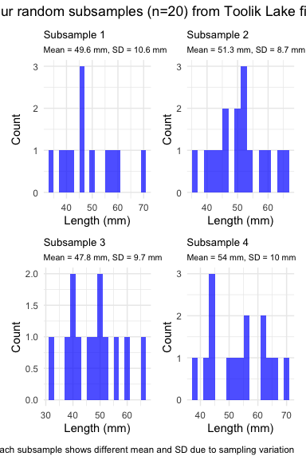
Lecture 4: Standard error
Every sample gives slightly different estimate of µ
Can take many samples and calculate means
plot the frequency distribution of means
get the “sampling distribution of means”

Slide 25
Lecture 4: Standard error
3 important properties:
Sampling distribution of means (SDM) from normal population will be normal
Large Sampling distribution of means from any population will be normal (Central Limit Theorem)
The mean of Sampling distribution of means will equal µ or the mean

Slide 26
Lecture 4: Standard error
Given above
can estimate the standard deviation of sample means
“Standard error of sample mean”
How good is your estimate of population mean? (based on the sample collected)
quantifies how much the sample means are expected to vary from samples
gives an estimate of the error associated with using $\overset{‾}{y}$ to estimate $μ$…

Slide 27
Lecture 4: Standard error
$σ_{\overset{‾}{y}}=\frac{σ}{\sqrt{n}}$
but rarely know σ, so use s $s_{\overset{‾}{y}}=\frac{s}{\sqrt{n}}$ Where: $s_{\overset{‾}{y}}$ = sample standard error of mean s = sample standard deviation n = sample size

Slide 28
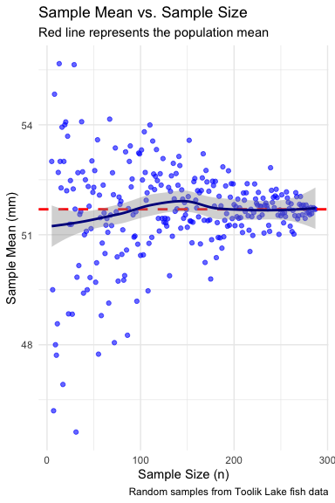
Lecture 4: Standard error
Notice: - $s_{\overset{‾}{y}}$ depends on - sample s (standard deviation) - sample n - ($s_{\overset{‾}{y}}=\frac{s}{\sqrt{n}}$)
How and why? - Decreases with sample n - number - increases with sample s - standard deviation
Large sample, low s = greater confidence in estimate of $μ$

Slide 29
Lecture 4: Confidence intervals
Every sample gives slightly different estimate of µ (population mean)
Want to know how accurate our estimate of µ is from a sample
Do this by calculating confidence interval:
Range of values that will contain the true population mean with a certain probability

Slide 30
Practice Exercise 6: Calculating Confidence Intervals
Let’s calculate 95% confidence intervals for the mean fish length in Toolik Lake:
# Calculate the standard error for Toolik Lake toolik_se <- toolik_result$sd / sqrt(toolik_result$count) # Calculate the 95% confidence interval using the normal distribution # (since our sample size is large) toolik_ci_lower <- toolik_result$mean - 1.96 * toolik_se toolik_ci_upper <- toolik_result$mean + 1.96 * toolik_se # Print the results cat("Mean fish length in Toolik Lake:", round(toolik_result$mean, 1), "mm\n")
Mean fish length in Toolik Lake: 51.7 mm
cat("95% Confidence Interval:", round(toolik_ci_lower, 1), "to", round(toolik_ci_upper, 1), "mm\n")
95% Confidence Interval: 50.1 to 53.3 mm
Now choose another lake and calculate its 95% confidence interval:
# Choose another lake (e.g., "E 01") my_lake <- "E 01" # You can change this to any lake in the dataset # Filter data for your chosen lake my_lake_data <- sculpin_df %>% filter(lake == my_lake) # Calculate mean, standard deviation, and standard error my_lake_stats <- my_lake_data %>% summarize( mean = mean(total_length_mm, na.rm = TRUE), sd = sd(total_length_mm, na.rm = TRUE), n = sum(!is.na(total_length_mm)), se = sd / sqrt(n) ) # Calculate 95% confidence interval my_lake_ci_lower <- my_lake_stats$mean - 1.96 * my_lake_stats$se my_lake_ci_upper <- my_lake_stats$mean + 1.96 * my_lake_stats$se # Print results cat("Mean fish length in", my_lake, ":", round(my_lake_stats$mean, 1), "mm\n")
Mean fish length in E 01 : 58.2 mm
cat("95% Confidence Interval:", round(my_lake_ci_lower, 1), "to", round(my_lake_ci_upper, 1), "mm\n")
95% Confidence Interval: 54.8 to 61.6 mm
Do the confidence intervals for these two lakes overlap? What does this suggest about the difference between the fish populations?

Slide 31
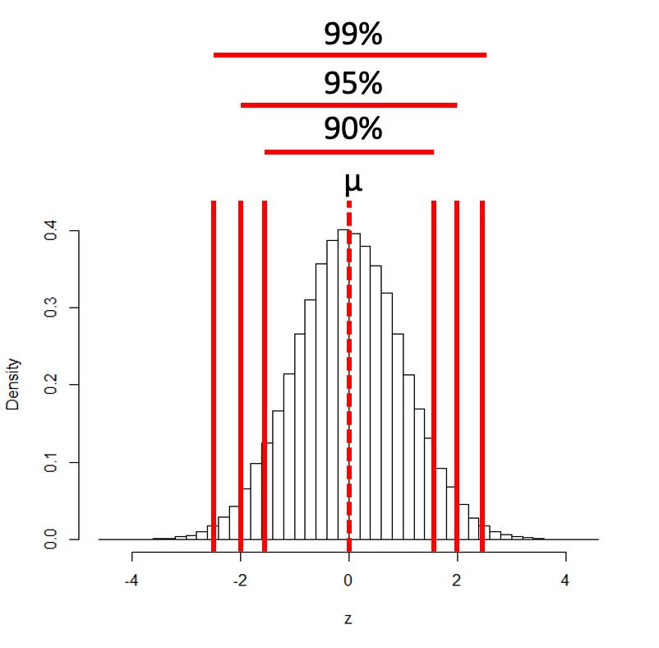
Lecture 4: Confidence intervals
Often calculate 95% CIs
Interpret 95% CI to mean:
Range of values that contains µ (population mean) with 95% probability
More correctly:
If we took 100 samples from population
calculate a CI from each
95 of the 100 CIs will contain the true population mean - µ

Slide 32
Lecture 4: Confidence intervals
Formula for confidence interval
$\text{95\% CI}=\overset{‾}{y}±z⋅\frac{σ}{\sqrt{n}}$
Where:
ȳ is the sample mean
𝑛 is the sample size
σ is the population standard deviation
z is the z-value corresponding the probability of the CI

Slide 33
Lecture 4: Confidence intervals
Formula for confidence interval
$\text{95\% CI}=\overset{‾}{y}±z⋅\frac{σ}{\sqrt{n}}$
95% of probability of SND is bw z= -1.96 and z=1.96
So for:
95% CI z = 1.960
90% CI z = 1.645
99% CI z = 2.576
And so on….

Slide 34
Lecture 4: Confidence intervals
In the more typical case DON’T know the population σ - estimate it from the sample s When don’t know the population σ - and when sample size is < ~30) - can’t use the standard normal (z) distribution
Instead, we use Student’s t distribution

Slide 35
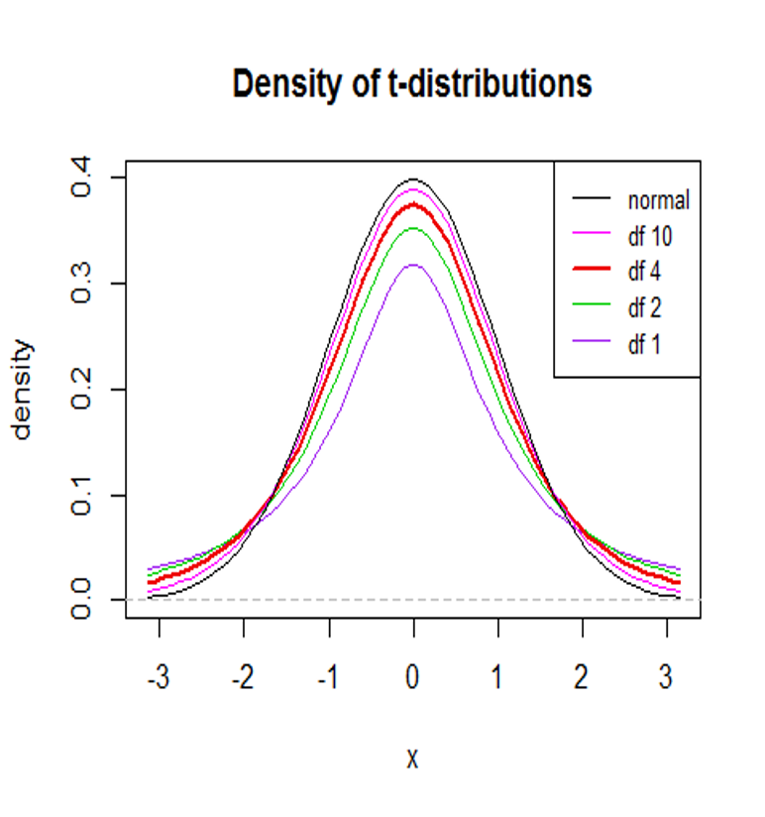
Lecture 4: Student’s t-distribution
Student’s t distribution similar to SND
changes depending on degrees of freedom (df= n-1)
t distribution more “conservative”
smaller n is, the more conservative the t distribution is
At df = ~30 - t distribution becomes close to z distribution

Slide 36
Practice Exercise 7: Using the t-Distribution
When working with small samples or when the population standard deviation is unknown, we use the t-distribution. Let’s take a small sample and calculate a confidence interval using the t-distribution:
# Set seed for reproducibility set.seed(789) # Take a small sample of 15 fish from Toolik Lake small_sample <- toolik_df %>% sample_n(15) # Calculate sample statistics small_mean <- mean(small_sample$total_length_mm, na.rm = TRUE) small_sd <- sd(small_sample$total_length_mm, na.rm = TRUE) small_n <- 15 small_se <- small_sd / sqrt(small_n) # Calculate degrees of freedom df <- small_n - 1 # Find the critical t-value for 95% confidence interval t_critical <- qt(0.975, df) # 0.975 for a two-tailed 95% CI # Calculate the confidence interval small_ci_lower <- small_mean - t_critical * small_se small_ci_upper <- small_mean + t_critical * small_se # Print the results cat("Small sample (n=15) mean:", round(small_mean, 1), "mm\n")
Small sample (n=15) mean: 57.3 mm
cat("t-critical value (df=14):", round(t_critical, 3), "\n")
t-critical value (df=14): 2.145
cat("95% CI using t-distribution:", round(small_ci_lower, 1), "to", round(small_ci_upper, 1), "mm\n")
95% CI using t-distribution: 52.7 to 61.9 mm
# For comparison, calculate the CI using the normal distribution (z) z_critical <- 1.96 z_ci_lower <- small_mean - z_critical * small_se z_ci_upper <- small_mean + z_critical * small_se cat("95% CI using normal distribution:", round(z_ci_lower, 1), "to", round(z_ci_upper, 1), "mm\n")
95% CI using normal distribution: 53.1 to 61.5 mm
Which confidence interval is wider? Why is this the case?

Slide 37
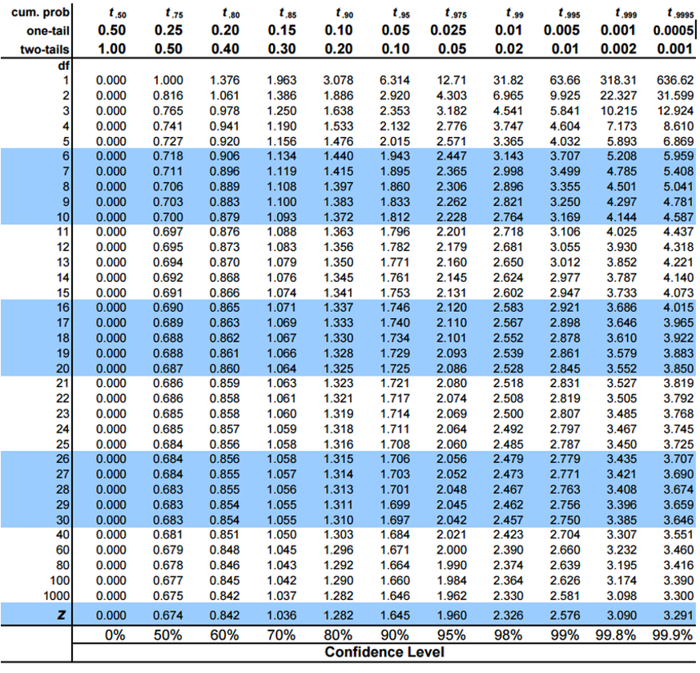
Lecture 4: Student’s t-distribution
To calculate CI for sample from “unknown” population:
$\text{CI}=\overset{‾}{y}±t⋅\frac{s}{\sqrt{n}}$
Where:
ȳ is sample mean
𝑛 is sample size
s is sample standard deviation
t t-value corresponding the probability of the CI
t in t-table for different degrees of freedom (n-1)

Slide 38
Lecture 4: Student’s t-distribution
Here is a t-table
Values of t that correspond to probabilities
Probabilities listed along top
Sample dfs are listed in the left-most column
Probabilities are given for one-tailed and two-tailed “questions”

Slide 39
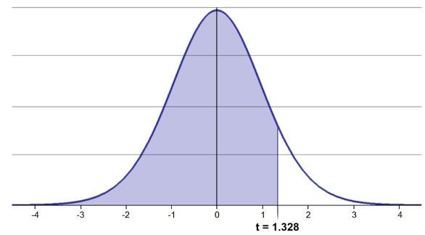
Lecture 4: Student’s t-distribution
One-tailed questions: area of distribution left or (right) of a certain value
n=20 (df=19) - 90% of the observations found left
t= 1.328 (10% are outside)

Slide 40
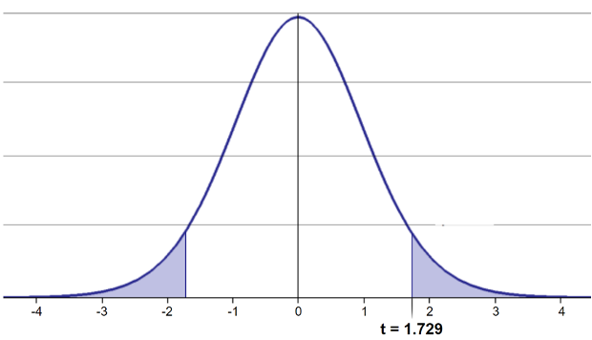
Lecture 4: Student’s t-distribution
Two-tailed questions refer to area between certain values
n= 20 (df=19), 90% of the observations are between
t=-1.729 and t=1.729 (10% are outside)

Slide 41
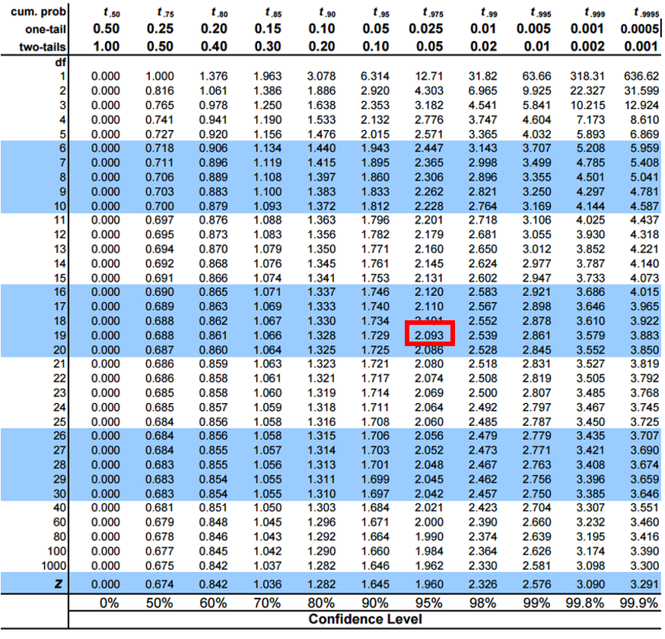
Lecture 4: Student’s t-distribution
Let’s calculate CIs again:
Use two-sided test
95% CI Sample A: = 51.7 ± 1.984 * (12/(208^0.5)) = 1.650788
The 95% CI is between 50.05 and 53.35
“The 95% CI for the population mean from sample A is 51.7 ± 1.65”

Slide 42
Lecture 4: Student’s t-distribution
So:
Can assess confidence that population mean is within a certain range
Can use t distribution to ask questions like:
“What is probability of getting sample with mean = ȳ from population with mean = µ?” (1 sample t-test)
“What is the probability that two samples came from same population?” (2 sample t-test)
Practice Exercise 8: One-Sample t-Test
Let’s perform a one-sample t-test to determine if the mean fish length in Toolik Lake differs from 50 mm:
# Perform a one-sample t-test t_test_result <- t.test(toolik_df$total_length_mm, mu = 50) # View the test results t_test_result
One Sample t-test data: toolik_df$total_length_mm t = 2.0326, df = 207, p-value = 0.04337 alternative hypothesis: true mean is not equal to 50 95 percent confidence interval: 50.05097 53.33845 sample estimates: mean of x 51.69471
Interpret this test result by answering these questions: 1. What was the null hypothesis? 2. What was the alternative hypothesis? 3. What does the p-value tell us? 4. Should we reject or fail to reject the null hypothesis at α = 0.05? 5. What is the practical interpretation of this result for fish biologists?

Slide 43
Lecture 4: Next steps
For example
what is probability that population X is the same as our lakes population?
How would you assess this question using what we learned?
Practice Exercise 9: Two-Sample t-Test
Let’s compare fish lengths between two lakes to see if they differ:
# Choose two lakes to compare lake1 <- "Toolik" lake2 <- "E 01" # Change this to another lake if you prefer # Filter data for the two lakes lake1_data <- sculpin_df %>% filter(lake == lake1) %>% pull(total_length_mm) lake2_data <- sculpin_df %>% filter(lake == lake2) %>% pull(total_length_mm) # Perform a two-sample t-test lakes_ttest <- t.test(lake1_data, lake2_data) # View the results lakes_ttest
Welch Two Sample t-test data: lake1_data and lake2_data t = -3.4051, df = 116.36, p-value = 0.0009082 alternative hypothesis: true difference in means is not equal to 0 95 percent confidence interval: -10.313036 -2.727921 sample estimates: mean of x mean of y 51.69471 58.21519
Now create a boxplot to visualize the difference in fish lengths between these lakes:
# Create a boxplot comparing the two lakes sculpin_df %>% filter(lake %in% c(lake1, lake2)) %>% ggplot(aes(x = lake, y = total_length_mm, fill = lake)) + geom_boxplot() + labs( title = paste("Comparison of Fish Lengths in", lake1, "and", lake2), x = "Lake", y = "Length (mm)" ) + theme_minimal()
Based on the t-test results and the boxplot, what can you conclude about the fish populations in these two lakes?

Slide 44
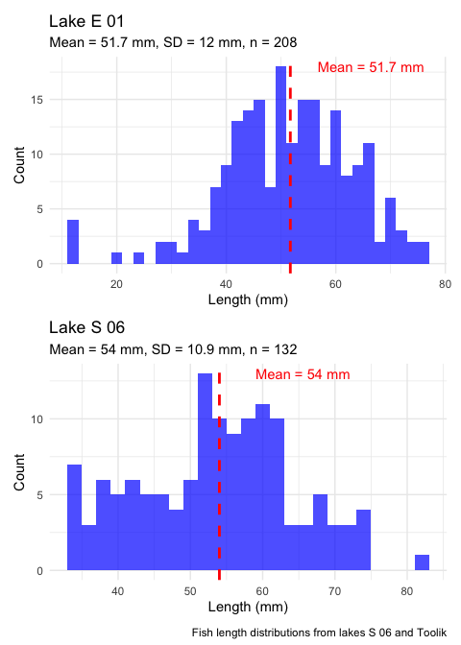
Lecture 4: Next steps
Let’s calculate the 95% CI for population X
Use two-sided test
95% CI Sample X: = 54 ± 1.984 * (10.9/(132^0.5)) = 1.882267 The 95% CI is between 52.12 and 55.88
Notice: the 95% confidence interval contains 51.7
What does this tell us about population X?

Slide 45
Lecture 4: Statistical hypothesis testing
Major goal of statistics:
inferences about populations from samples assign degree of confidence to inferences
Statistical H-testing:
formalized approach to inference
hypotheses ask whether samples come from populations with certain properties
often interested in questions about population means (but not only)

Slide 46
Lecture 4: Statistical hypothesis testing
Relies on specifying null hypothesis (Ho) and alternate hypothesis (Ha)
Ho is the hypothesis of “no effect”
(two samples from population with same mean, sample is from population of mean=0)
Ha (research hypothesis) the opposite of the Ho

Slide 47
Practice Exercise 10: Formulating Hypotheses
For the following scenarios, write out the null and alternative hypotheses:
Testing if the mean fish length in Lake S 06 is greater than 50 mm.
Testing if there is a difference in mean fish lengths between lakes Toolik and S 06.
Testing if lake E 01 has a higher variance in fish lengths compared to Lake Toolik.
For each scenario, remember that the null hypothesis typically represents “no effect” or “no difference”, while the alternative hypothesis represents what you are trying to demonstrate.

Slide 48
Lecture 4: Statistical hypothesis testing
p = 0.3 means that if study repeated 100 times
would get this (or more extreme) result due to chance 30 times
p = 0.03 means that if study repeated 100 times
would get this (or more extreme) result due to chance 3 times
Which p-value suggests Ho likely false?

Slide 49
Lecture 4: Statistical hypothesis testing
At what point reject Ho?
p < 0.05 conventional “significance threshold” (α)
p < 0.05 means:
if Ho is true - if study repeated 100 times
would get this (or more extreme) result less than 5 times due to chance

Slide 50
Lecture 4: Statistical hypothesis testing
α is the rate at which we will reject a true null hypothesis (Type I error rate)
Lowering α will lower likelihood of incorrectly rejecting a true null hypothesis (e.g., 0.01, 0.001)
Both hypotheses and α are specified BEFORE collection of data and analysis

Slide 51
Lecture 4: Statistical hypothesis testing
Traditionally α=0.05 is used as a cut off for rejecting null hypothesis
Nothing magical about 0.0 - actual p-values need to be reported.
p-value range | Interpretation
P > 0.10 | No evidence against Ho - data appear consistent with Ho
0.05 < P < 0.10 | Weak evidence against the Ho in favor of Ha
0.01 < P < 0.05 | Moderate evidence against Ho in favor of Ha
0.001 < P < 0.01 | Strong evidence against Ho in favor of Ha
P < 0.001 | Very strong evidence against Ho in favor of Ha

Slide 52

Lecture 4: Statistical hypothesis testing
Fisher:
p-value as informal measure of discrepancy betwen data and Ho
“If p is between 0.1 and 0.9 there is certainly no reason to suspect the hypothesis tested. If it is below 0.02 it is strongly indicated that the hypothesis fails to account for the whole of the facts. We shall not often be astray if we draw a conventional line at .05 …”

Slide 53
Lecture 4: Statistical hypothesis testing
General procedure for H testing:
Specify Null (Ho) and alternate (Ha)
Determine test (and test statistic) to be used
Test statistic is used to compare your data to expectation under Ho (null hypothesis)
Specify significance (α or p value) level below which Ho will be rejected

Slide 54
Lecture 4: Statistical hypothesis testing
General procedure for H testing:
Collect data - Perform test
If p-value < α, conclude Ho is likely false and reject it
If p-value > α, conclude no evidence Ho is false and retain it

Slide 55
Final Exercise: Comprehensive Analysis
You’ve learned about standard normal distributions, z-scores, standard error, confidence intervals, and hypothesis testing. Now, put it all together with a comprehensive analysis of fish lengths from multiple lakes.
# Choose 3 lakes for comparison lakes_to_compare <- c("Toolik", "E 01", "S 06") # Filter data for these lakes comparison_data <- sculpin_df %>% filter(lake %in% lakes_to_compare) %>% filter(!is.na(total_length_mm)) # 1. Calculate summary statistics for each lake lake_stats <- comparison_data %>% group_by(lake) %>% summarize( mean_length = mean(total_length_mm, na.rm = TRUE), sd_length = sd(total_length_mm, na.rm = TRUE), n = sum(!is.na(total_length_mm)), se_length = sd_length / sqrt(n), ci_lower = mean_length - qt(0.975, n-1) * se_length, ci_upper = mean_length + qt(0.975, n-1) * se_length ) # Display the summary statistics lake_stats
# A tibble: 3 × 7 lake mean_length sd_length n se_length ci_lower ci_upper <chr> <dbl> <dbl> <int> <dbl> <dbl> <dbl> 1 E 01 58.2 15.3 79 1.72 54.8 61.6 2 S 06 54.0 10.9 132 0.949 52.1 55.9 3 Toolik 51.7 12.0 208 0.834 50.1 53.3
# 2. Create boxplots to visualize the distributions comparison_data %>% ggplot(aes(x = lake, y = total_length_mm, fill = lake)) + geom_boxplot() + labs( title = "Fish Length Distributions Across Lakes", x = "Lake", y = "Length (mm)" ) + theme_minimal()
# 3. Perform ANOVA to test for differences among the lakes lake_anova <- aov(total_length_mm ~ lake, data = comparison_data) summary(lake_anova)
Df Sum Sq Mean Sq F value Pr(>F) lake 2 2459 1229.6 8.018 0.000383 *** Residuals 416 63800 153.4 --- Signif. codes: 0 '***' 0.001 '**' 0.01 '*' 0.05 '.' 0.1 ' ' 1
# 4. If ANOVA is significant, perform post-hoc tests if(summary(lake_anova)[[1]]["Pr(>F)"][1,] < 0.05) { tukey_results <- TukeyHSD(lake_anova) print(tukey_results) }
Tukey multiple comparisons of means 95% family-wise confidence level Fit: aov(formula = total_length_mm ~ lake, data = comparison_data) $lake diff lwr upr p adj S 06-E 01 -4.200038 -8.343516 -0.05656054 0.0461139 Toolik-E 01 -6.520478 -10.370118 -2.67083905 0.0002356 Toolik-S 06 -2.320440 -5.561933 0.92105332 0.2126069
Based on this analysis, write a short summary of your findings: 1. Are there significant differences in fish lengths between the lakes? 2. Which lakes have the largest and smallest fish on average? 3. How do the confidence intervals compare across lakes? 4. What might explain these differences in fish lengths between lakes?

Slide 56
Lecture 6: heading 1
text
place to put figure with this text

